Slide 1
FY 2019 Early Budget Driver Discussion
Economic Development
A Guide to Conducting a Regulatory Impact Analysis:
The GOMB Criteria
Last updated 5/17/18

Slide 2
Why the Analysis?
Executive Order No. 2017-1 and House Bill 272 of the 2017 General Legislative Session jointly require state rule filing entities to conduct a thorough regulatory impact analysis consistent with the criteria established by the Governor’s Office of Management and Budget (GOMB) when filing a proposed rule.
The methodology presented herein constitutes the criteria by which all rule filing entities shall produce their regulatory impact analyses.
This presentation describes the methodology and provides two examples of how the methodology should be applied in practice.
A Guide to Conducting a Regulatory Impact Analysis: The GOMB Criteria

Slide 3
The Methodology
The Methodology of a Regulatory Impact Analysis: The GOMB Criteria
A Guide to Conducting a Regulatory Impact Analysis: The GOMB Criteria

Slide 4
The Methodology
Steps in Conducting a Regulatory Impact Analysis
The methodology and the examples will follow the same exact steps to illustrate how the methodology should be applied:
Identify affected parties and the impacts
Count the number of individuals in each affected party
Measure the fiscal impacts
Record the required information
A Guide to Conducting a Regulatory Impact Analysis: The GOMB Criteria

Slide 5
The Methodology
And remember… there is not one “right” answer.
This methodology is meant to be a dynamic tool that can be applied in a uniform way to analyze the various impacts of proposed rules.
Different people using this tool will likely come up with different answers given the same rule to analyze.
However, there are good, better, best, and also incorrect answers.
Ultimately, agencies must be able to defend their analyses.
A Guide to Conducting a Regulatory Impact Analysis: The GOMB Criteria

Slide 6
The Methodology
Step 1: Identify Affected Parties and Impacts
The five classes of potentially affected parties are the following:
State Government
Local Government
Small Businesses (fewer than 50 employees)
Non-Small Businesses (50 or more employees)
Other Persons (citizens, organizations, etc.)
To know which parties must be included in the analysis requires understanding the various types of impacts and the identification procedure presented in the following slides.
A Guide to Conducting a Regulatory Impact Analysis: The GOMB Criteria

Slide 7
The Methodology
Step 1: Identify Affected Parties and Impacts
Executive Order 2017-1 states that “each agency shall include as part of the rule analysis the anticipated costs or savings in terms of fiscal and non-fiscal impacts and burdens a rule may have directly and indirectly to” all affected parties.
The six terms above produce eight types of impacts:
Definitions of these terms will be presented in the following slides.
1. Direct Fiscal Cost | 5. Direct Fiscal Benefit
2. Indirect Fiscal Cost | 6. Indirect Fiscal Benefit
3. Direct Non-Fiscal Cost | 7. Direct Non-Fiscal Benefit
4. Indirect Non-Fiscal Cost | 8. Indirect Non-Fiscal Benefit
A Guide to Conducting a Regulatory Impact Analysis: The GOMB Criteria
Notes:
Underlined the six terms so it’s more apparent what they are when reading the second bulletpoint

Slide 8
The Methodology
Step 1: Identify Affected Parties and Impacts
The impacts of proposed bills or rules are commonly described using the terms “revenues,” “expenditures,” “savings,” and “costs.” The more general terms “costs” and “benefits” are used here to provide greater precision in the definitions.
Definition – Benefit: An impact that positively affects a party.
Definition – Cost: An impact that negatively affects a party.
A Guide to Conducting a Regulatory Impact Analysis: The GOMB Criteria

Slide 9
The Methodology
Step 1: Identify Affected Parties and Impacts
Fiscal and non-fiscal impacts are defined in terms of whether money is involved in the exchanges between parties.
Definition – Fiscal Impact: A cost or benefit has a fiscal impact when the imposition of a rule changes the price or quantity of the exchanges between any two affected parties and the transactions involve monetary exchanges.
Definition – Non-Fiscal Impact: A cost or benefit has a non-fiscal impact when the imposition of a rule changes the quantity of exchanges between any two affected parties, but the transactions do not involve monetary exchanges.
A Guide to Conducting a Regulatory Impact Analysis: The GOMB Criteria

Slide 10
The Methodology
Step 1: Identify Affected Parties and Impacts
The goal is to measure fiscal impacts as precisely as possible, whereas non-fiscal impacts are not measurable in dollars. However, cases sometimes arise where an impact is known to be fiscal, but it is virtually impossible to estimate due to a lack of data, the high cost of conducting the research to collect the data, or an inability to obtain unbiased data. In this case, the impact should be acknowledged as fiscal, but inestimable.
Inestimable fiscal impacts must be reported along with a characterization of why the fiscal impacts are inestimable.
Definition – Inestimable Fiscal Impact: A fiscal cost or fiscal benefit that cannot be quantified because the relevant data is unavailable and the cost of acquiring the relevant data is prohibitively expensive.
A Guide to Conducting a Regulatory Impact Analysis: The GOMB Criteria

Slide 11
The Methodology
Step 1: Identify Affected Parties and Impacts
The definitions of direct and indirect impacts require the concept of a “constrained party.” The constrained party will be the group understood as directly impacted, while those who the constrained party interacts with that are affected as a result of a rule are indirectly impacted parties.
Constrained Party
Definition – Constrained Party: A group of individuals specifically identified within the language of a rule whose range of possible behavior is limited or expanded, with respect to exchanges with other parties, due to the rule forbidding or permitting certain types of activities in which this group can engage.
Indirectly Impacted Parties
A Guide to Conducting a Regulatory Impact Analysis: The GOMB Criteria

Slide 12
The Methodology
Step 1: Identify Affected Parties and Impacts
Using the concept of a constrained party enables clear definitions of direct and indirect impacts.
Definition – Direct Impact: A party experiences a direct impact if, by the imposition of a rule, it experiences a cost or benefit and it is a constrained party.
Definition – Indirect Impact: A party experiences an indirect impact if, by the imposition of a rule, it experiences a cost or benefit and it is not a constrained party.
A Guide to Conducting a Regulatory Impact Analysis: The GOMB Criteria

Slide 13
The Methodology
Step 1: Identify Affected Parties and Impacts
All of the definitions presented thus far are general in nature. However, to this analysis executable in practice, some limitations must be imposed.
The measurement of indirect impacts must be limited because they theoretically could pass from one party to a second party, from the second to a third party, from the third party to a fourth, and so forth.
In the next slide, a list is given that specifies all of the affected parties whose impacts must be measured and recorded by rule filing entities.
A Guide to Conducting a Regulatory Impact Analysis: The GOMB Criteria
Notes:
Changed “However, to this analysis executable in practice, some limitations must be imposed.”
To
However, for this analysis to be executable in practice, some limitations must be imposed.

Slide 14
The Methodology
Step 1: Identify Affected Parties and Impacts
The Constrained Party:
Direct fiscal impacts
Direct non-fiscal impacts
Inestimable direct fiscal impacts along with characterization of why the fiscal impacts are inestimable.
State and Local Government
All Indirect fiscal impacts, no matter how distant they are from the exchange relationship with the constrained party.
Small Business, Non-Small Business, and Other Persons
if any of these parties are indirectly impacted by the constrained party and they engage in the same immediate markets with the constrained party, then the following must be reported:
All indirect impacts
Inestimable direct fiscal impacts along with characterization of why the fiscal impacts are inestimable.
All indirect non-fiscal impacts
A Guide to Conducting a Regulatory Impact Analysis: The GOMB Criteria

Slide 15
The Methodology
Step 1: Identify Affected Parties and Impacts
An illustration of the scope of indirect impacts to be measured and reported
The Constrained Party
Group C Demands Goods or Services Supplied by the Constrained Party
Group B Supplies Goods or Services Demanded by the Constrained Party
Group A Supplies Goods or Services Demand by the Constrained Party
A Guide to Conducting a Regulatory Impact Analysis: The GOMB Criteria

Slide 16
The Methodology
Step 2: Count the Number of Affected Individuals
Providing a count of the number of businesses or individuals affected is required for understanding the breadth of a rule’s impact on society.
Affected parties requiring counts are the following:
Small businesses
Non-small businesses
Other persons (provide counts for each group)
A Guide to Conducting a Regulatory Impact Analysis: The GOMB Criteria

Slide 17
The Methodology
Step 2: Count the Number of Affected Individuals
Many resources are available for gathering counts of affected individuals; two are listed below and will be discussed later in the case examples (See slides 31, 60, and 67) .
NAICS Website
https://www.census.gov/eos/www/naics/
DWS FirmFind
https://jobs.utah.gov/jsp/firmfind/#/
A Guide to Conducting a Regulatory Impact Analysis: The GOMB Criteria

Slide 18
The Methodology
Step 3: Estimate the Fiscal Impacts
When estimating a fiscal impact, it should be measured relative to a baseline.
Definition – Baseline: The current state of all exchange or market relationships among all parties before the imposition of a proposed rule.
Rule filing entities will generally need to determine two types of impacts:
An annual average fiscal impact for a typical member of an affected party relative to a baseline
An annual total fiscal impact for the affected party (multiply the count of affected individuals per party by the annual average fiscal impact per individual)
A Guide to Conducting a Regulatory Impact Analysis: The GOMB Criteria

Slide 19
The Methodology
Step 4: Record the Required Information
Note: For all Step 4 slides, the number preceding the bolded text refers to the box number in the eRules System wherein rule filers must enter the required narrative, which will be explained in the following slides.
Example:
Slide 20
eRules System
**Slide 20 corresponds with box 7A in the eRules System
A Guide to Conducting a Regulatory Impact Analysis: The GOMB Criteria

Slide 20
The Methodology
Step 4: Record the Required Information
7. Aggregate anticipated cost or savings to:
A. State Budget: Describe how the state will be impacted and identify types of impacts to the state. Include the estimated fiscal costs and benefits to the state budget. Make sure to include fiscal impacts to the state no matter how far removed they are from the constrained party. Provide enough detail that the reader can understand the various assumptions made in arriving at the estimates. If the state is not impacted, report that the proposed rule is not expected to impact state revenues or expenditures and explain why.
A Guide to Conducting a Regulatory Impact Analysis: The GOMB Criteria

Slide 21
The Methodology
Step 4: Record the Required Information
7. Aggregate anticipated cost or savings to:
B. Local Government: Describe how local governments will be impacted and identify types of impacts to local government. Include the estimated fiscal costs and benefits. State how many local governments will be affected. Make sure to include fiscal impacts to local governments no matter how far removed they are from the constrained party. Provide enough detail that the reader can understand the various assumptions made in arriving at the estimates. If local governments are not impacted, report that the proposed rule is not expected to impact local governments revenues or expenditures and explain why.
A Guide to Conducting a Regulatory Impact Analysis: The GOMB Criteria

Slide 22
The Methodology
Step 4: Record the Required Information
7. Aggregate anticipated cost or savings to:
C. Small Businesses:
Briefly describe why small businesses in Utah will be affected by the rule
Identify all industries affected by name and NAICS code (obtained from NAICS website or DWS FirmFind)
Provide a count of the small businesses affected
State all anticipated impact types to small business
Describe the individual-level fiscal impacts (both costs and benefits) and include an annual estimate of the total impact on small businesses
Indicate whether the costs are one-time or on-going
Include a description of any fiscal impacts that were inestimable
Include a description of any relevant non-fiscal impacts
A Guide to Conducting a Regulatory Impact Analysis: The GOMB Criteria

Slide 23
The Methodology
Step 4: Record the Required Information
Also required in Box 7C is the following:
7. Aggregate anticipated cost or savings to:
C. Small Businesses:
The reduction of negative impacts on small businesses: If there are direct negative impacts on small businesses in Utah, Utah Code 63G-3-301(6) requires a discussion of how the agency attempted to reduce the impact on small firms. If applicable, include the information in this box.
Note: In the case of indirect fiscal costs to small businesses, agencies do not need to attempt a reduction of negative impacts on small businesses. The reason being that indirect impacts occur only to businesses that are not constrained by the rule, so reduction of negative impacts is not required.
A Guide to Conducting a Regulatory Impact Analysis: The GOMB Criteria

Slide 24
The Methodology
Step 4: Record the Required Information
7. Aggregate anticipated cost or savings to:
D. Other Persons:
For each group of other persons in Utah, briefly describe how they will be affected by the rule.
Provide a count of individuals in each group
State all anticipated impact types to other persons
Describe the individual-level fiscal impacts (both costs and benefits) and include an annual estimate of the total impact on the group
Indicate whether the costs are one-time or on-going
If there are inestimable fiscal impacts, report them and why they are inestimable
Report any relevant non-fiscal impacts
A Guide to Conducting a Regulatory Impact Analysis: The GOMB Criteria

Slide 25
The Methodology
Step 4: Record the Required Information
9. Department Head Comments
A. Comments by the department head on the fiscal impact the rule may have on businesses: This should be a brief summary of the impacts to small and non-small businesses in Utah. Mentioning counts for small and non-small businesses and the types of impacts they will experience is probably sufficient.
To minimize redundancy, it is recommended the rule filing entity does not simply copy and paste the contents of Box 7C and Appendix 2 in this box.
A Guide to Conducting a Regulatory Impact Analysis: The GOMB Criteria

Slide 26
The Methodology
Step 4: Record the Required Information
15. Appendix 1 and 2 (.rtf Word Document)
For Appendix 1 and 2, use the template found at https://rules.utah.gov/agency-resources/
Scroll down to the file entitled “Fiscal Analysis Table Template to include within rules” word document.
Use this exact formatting for the RTF document in your submission, and delete the line stating “EXAMPLE NARRATIVE START”.
A Guide to Conducting a Regulatory Impact Analysis: The GOMB Criteria
Notes:
Changed 15. Appendix 1 and 2 (Word Document)
To
15. Appendix 1 and 2 (.rtf Word Document)

Slide 27
The Methodology
Step 4: Record the Required Information
15. Appendix 1: Regulatory Impact Summary Table
In the three-year table, enter totals of the direct and indirect annual fiscal impacts for each respective party. If the annual impacts will likely be the same every year, then the cost and benefit estimates for year one can be copied in for years two and three. If there are one-time costs and on-going costs, the figures may change over the three years for the affected parties.
15. Appendix 2: In the provided template below the Impact Summary Table, you will notice a section entitled “Appendix 2: Regulatory Impact to Non-Small Businesses”
In this appendix, follow the same steps for impacts to small business (slide 22) but only as it relates to non-small business (businesses with 50 or more employees).
See the next slide for how your word document should look.
A Guide to Conducting a Regulatory Impact Analysis: The GOMB Criteria
Notes:
Changed “but only as it relates to non-small business (businesses with more than 50 employees).”
To
“but only as it relates to non-small business (businesses with 50 or more employees).”

Slide 28
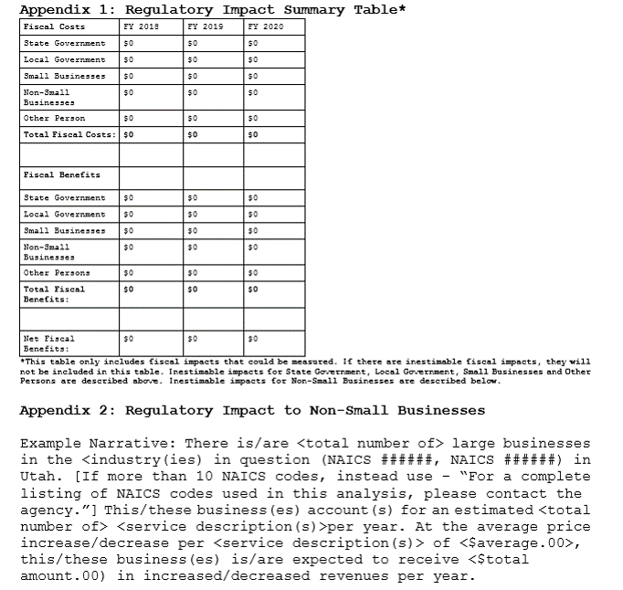
The Methodology
Step 4: Record the Required Information
Remember to follow the formatting in the template exactly:
Font
Font size
Table size
A Guide to Conducting a Regulatory Impact Analysis: The GOMB Criteria

Slide 29
Example No. 1: Ambulance Rates
Example No. 1: R426-8 Emergency Medical Services Ambulance Rates and Charges
A Guide to Conducting a Regulatory Impact Analysis: The GOMB Criteria

Slide 30
Example No. 1: Ambulance Rates
Example 1: R426-8 Ambulance Rates and Charges
This was an amendment to a rule posted in the Utah State Bulletin (2015-9).
The rule increases the maximum prices that ambulances can charge per transport.
This is an example of rules where a fee is imposed or a rate of payment is changed. In such cases, determining the fiscal impact is usually straightforward because the dollar amounts are typically listed in the rule. However, some research and simplifying assumptions may be required to complete the analysis.
Simplifying assumptions will often be necessary to conduct an analysis
A Guide to Conducting a Regulatory Impact Analysis: The GOMB Criteria

Slide 31
Example No. 1: Ambulance Rates
Step 1: Identify Affected Parties and Impacts
Begin by identifying the constrained party. In this case, ambulance companies constitute the constrained party because the rule permits them to charge a higher rate per person transported. But which of the five parties owns ambulance companies?
Go to the Census’s North American Industry Classification System (NAICS) webpage and search for the term “ambulance.” NAICS code 621910 seems to be the most applicable industry, which is “Ambulance services, air or ground.”
Go to the DWS FirmFind webpage and search for the code 621910. It will bring up all Utah firms in this industry.
We can see that local government, small businesses, and non-small businesses provide ambulance services.
A Guide to Conducting a Regulatory Impact Analysis: The GOMB Criteria

Slide 32
Example No. 1: Ambulance Rates
Step 1: Identify Affected Parties and Impacts
Next, consider all of the parties that are indirectly impacted starting with what ambulances supply.
Ambulances supply transport services, so an indirectly impacted group is the set of people who demand ambulance transportation. Call them transported individuals.
Transported individuals will experience an impact to the degree that their health insurance covers transport cost. So we should include health insurance companies.
A Guide to Conducting a Regulatory Impact Analysis: The GOMB Criteria

Slide 33
Example No. 1: Ambulance Rates
Step 1: Identify Affected Parties and Impacts
Now consider what ambulance companies demand as inputs in order to provide transport services.
EMTs and paramedics are indirectly impacted because they provide labor services to ambulance companies. The need to give raises to workers was mentioned in the rule justification.
The rules states that another reason for the rate increase is to pay for “increased equipment costs.” Thus, ambulance equipment, service, and sales businesses will be indirectly impacted by the rule.
A Guide to Conducting a Regulatory Impact Analysis: The GOMB Criteria

Slide 34
Example No. 1: Ambulance Rates
Step 1: Identify Affected Parties and Impacts
Now that affected parties have been identified, identify which type of impact each party will experience.
State Government: No Impact
Local Government: Direct Fiscal Benefit
Small Businesses:
Ambulance Transportation Services: Direct Fiscal Benefit
Health Insurance Companies: Indirect Fiscal Cost
Ambulance Equipment, Services, and Sales: Indirect Fiscal Benefit
Non-Small Businesses:
Ambulance Transportation Services: Direct Fiscal Benefit
Health Insurance Companies: Indirect Fiscal Cost
Other “Persons”
Transported Individuals: Indirect Fiscal Cost
EMTs and Paramedics: Indirect Fiscal Benefit
A Guide to Conducting a Regulatory Impact Analysis: The GOMB Criteria

Slide 35
Example No. 1: Ambulance Rates
Step 2: Count the Number of Affected Individuals
Beginning with ambulance companies, this data was found when answering the question of who owns the ambulance companies. The data, taken from DWS’s FirmFind, shows that ambulance companies are run by small businesses, non-small businesses, and local government and counts are as follows:
Ambulance Companies – Local Government = 14
Ambulance Companies – Small Businesses = 5
Ambulance Companies – Non-Small Businesses = 1
A Guide to Conducting a Regulatory Impact Analysis: The GOMB Criteria

Slide 36
Example No. 1: Ambulance Rates
Step 2: Count the Number of Affected Individuals
Estimate the number of transported individuals. This data was found by contacting the Department of Health’s Bureau of Emergency Medical Services and Preparedness. In 2016, there were 264,934 transports.
How many insurance companies were affected? Go to the NAICS webpage and search for health insurance. The industry is Direct Health and Medical Insurance Carriers (524114). Go to FirmFind at DWS, enter in the NAICS code, and the data will show that there are 50 health insurance companies in Utah.
A Guide to Conducting a Regulatory Impact Analysis: The GOMB Criteria

Slide 37
Example No. 1: Ambulance Rates
Step 2: Count the Number of Affected Individuals
Estimate the number of EMTs and paramedics.
Go to the Bureau of Labor Statistics (BLS) and find the Occupational Employment Statistics (OES) page. At the following link, the page shows a map of the US and by clicking on Utah it will bring up the current data: https://www.bls.gov/oes/current/oessrcst.htm
After searching for the term “emergency” in the table, the data show that there were approximately 1,860 EMTs and paramedics in 2016 in Utah.
A Guide to Conducting a Regulatory Impact Analysis: The GOMB Criteria

Slide 38
Example No. 1: Ambulance Rates
Step 2: Count the Number of Affected Individuals
Finally, estimate the number of firms that provide ambulance equipment, services, and sales in Utah.
Searching the NAICS webpage, ambulance equipment, services, and sales do not have their own narrow industries, but are contained in much larger industries. The relevant industries are Motor Vehicle Body Manufacturing (336211) and Automobile and Other Motor Vehicle Merchant Wholesalers (423110). After downloading the data from FirmFind at DWS, it requires some searching through the list to identify the ambulance-related companies. There is one small Utah business in each of these industries that appears to focus solely on ambulance repairs, services and sales. Thus, there are 2 ambulance equipment, services and sales small businesses in Utah.
A Guide to Conducting a Regulatory Impact Analysis: The GOMB Criteria

Slide 39
Example No. 1: Ambulance Rates
Step 3: Estimate the Fiscal Impacts
Begin by estimating the average direct fiscal benefit of a transport to an ambulance company.
Three different types of service with different rates are listed in the rule. From data requested from the Bureau of EMS and Preparedness, the total transports are broken out across the three types.
A table is shown in the next slide that describes a method to calculate the total increase in charges for each type of ambulance service.
Once the total amount is calculated, simply divide it by the total number of transports to arrive at an average increase in the price of a transport, which amounts to $58.38.
A Guide to Conducting a Regulatory Impact Analysis: The GOMB Criteria
Notes:
Italicized and underlined “direct fiscal benefit”

Slide 40
Example No. 1: Ambulance Rates
Step 3: Estimate the Fiscal Impacts
Type of Service | Rate Increase | 2016 Counts | Total Increase
Ground ambulance | $41 | 132,467 | $5,431,147
Advanced EMT and EMT-IA ground ambulance | $54 | 17,139 | $925,506
Paramedic ground ambulance | $79 | 115,328 | $9,110,912
Total |  | 264,934 | $15,467,565
( ($41 x 132,467) + ($54 x 17,139) + ($79 x 115,328) ) ÷ 264, 934 = $58.38
A Guide to Conducting a Regulatory Impact Analysis: The GOMB Criteria

Slide 41
Example No. 1: Ambulance Rates
Step 3: Estimate the Fiscal Impacts
After deriving the average fiscal impact per transport, the impact must be allocated to the ambulance companies in the different parties (local government, small and non-small business).
From the FirmFind data downloaded earlier in this example, employment ranges are provided for each company. Take the mid-point of this range as an approximation of the company’s size. Then calculate the percentage of employment in small businesses, non-small businesses, and local government.
The employment size is used to approximate the number of transports each group performs in a year. Multiply by the average price increase of transports and those will be the direct fiscal benefits to each group.
The calculations are represented in the table on the next slide.
A Guide to Conducting a Regulatory Impact Analysis: The GOMB Criteria

Slide 42
Example No. 1: Ambulance Rates
Step 3: Estimate the Fiscal Impacts
Ambulance Companies | Counts | Employed | Percent of Total Emp | Transports | At $58.38 per Transport
Non-Small Business | 1 | 483 | 43.6% | 115,490 | $6,742,316
Small Business | 5 | 95 | 8.6% | 22,715 | $1,326,128
Local Government | 14 | 530 | 47.8% | 126,728 | $7,398,401
Totals | 20 | 1108 | 100.0% | 264,934 | $15,466,846
A Guide to Conducting a Regulatory Impact Analysis: The GOMB Criteria

Slide 43
Example No. 1: Ambulance Rates
Step 3: Estimate the Fiscal Impacts
Estimate the indirect fiscal costs to transported individuals and health insurance companies.
From the previous calculations, the average indirect fiscal cost per transport is $58.38.
How many transported individuals have insurance? Are they high-deductible plans? What is the rate at which health insurance companies will cover a transport?
This appears to be a case of an inestimable fiscal impact. The cost of researching this issue seems likely to be unreasonably high. In this case, provide the average cost, the number of transports, and the total cost shared by both groups.
A Guide to Conducting a Regulatory Impact Analysis: The GOMB Criteria
Notes:
Italicized and underlined “indirect fiscal costs”

Slide 44
Example No. 1: Ambulance Rates
Step 3: Estimate the Fiscal Impacts
Estimate the indirect fiscal benefits to EMTs and paramedics and for the ambulance equipment, services, and sales businesses.
To estimate the benefits that these two groups would receive requires knowing how the increased revenue received by ambulance companies is divided among spending on EMTs, equipment, and retained earnings by private businesses.
Again, it appears that this is an inestimable fiscal impact. The research costs to acquire this data will likely be high. Private firms may be reluctant to reveal such information, which is another difficulty. Therefore, the best approach is to provide the information that is available and describe the likely benefits received by these groups.
A Guide to Conducting a Regulatory Impact Analysis: The GOMB Criteria
Notes:
Italicized and underlined “indirect fiscal benefits”

Slide 45
Example No. 1: Ambulance Rates
Step 4: Record the Required Information
7. Aggregate anticipated cost or savings to:
A. State Budget: This rule is not expected to have any impacts on state government revenues or expenditures because the state does not own any ambulance companies and will not be an affected party.
B. Local Government: Across the State of Utah, 14 local government agencies provide ambulance transport services. It is estimated these local government service providers supply 126,728 transports annually. With the average increase in transport rates estimated at $58.38, local governments are expected to receive an increase in revenues of approximately $7.4 million.
A Guide to Conducting a Regulatory Impact Analysis: The GOMB Criteria

Slide 46
Example No. 1: Ambulance Rates
Step 4: Record the Required Information
7. Aggregate anticipated cost or savings to:
C. Small Businesses: Only five small businesses in Utah provide ambulance transportation services (NAICS 621910). These five firms provide approximately 22,715 transports per year. With the increase in the average transport rate to $58.38, these small businesses will see a direct fiscal benefit in revenues of just over $1.3 million. Utah health insurance businesses (NAICS 524114) will experience an inestimable indirect fiscal cost, and 42 of these are small businesses. This is inestimable as the cost of researching this issue seems likely to be unreasonably high. Ambulance equipment, service, and sales (NAICS 336211 and 423110) are provided by two small businesses in Utah, and they are expected to receive an indirect fiscal benefit as ambulance companies buy more equipment and services. The precise fiscal cost to small health insurance businesses and the indirect revenues to ambulance equipment, service, and sales businesses cannot be estimated due to the unavailability of data and the high cost of conducting research to determine the estimates.
A Guide to Conducting a Regulatory Impact Analysis: The GOMB Criteria

Slide 47
Example No. 1: Ambulance Rates
Step 4: Record the Required Information
7. Aggregate anticipated cost or savings to:
D. Other Persons: An estimated 264,934 individuals will be transported per year at an increased average cost of $58.38 per transport. The total indirect fiscal cost will be approximately $15.5 million per year. Transported individuals and health insurance companies will share the indirect fiscal costs depending on how many are insured and the nature of the insurance plans. As many as 1,860 EMTs and paramedic will likely experience an indirect fiscal benefit through increased wages as ambulance companies will have increased revenues. An exact estimate of the fiscal benefit to EMTs is not possible because the data necessary to determine how increased revenue for ambulance companies is allocated to labor, equipment, repairs, and retained earnings is not available.
A Guide to Conducting a Regulatory Impact Analysis: The GOMB Criteria

Slide 48
Example No. 1: Ambulance Rates
Step 4: Record the Required Information
9. Department Head Comments
A. Comments by the department head on the fiscal impact the rule may have on businesses: As for small businesses, 5 Utah ambulance transport providers will see increased revenues from the new rates. As many as 42 small health insurance businesses in Utah may incur increased costs. In addition, 2 small ambulance equipment, services and sales businesses will likely see increased revenue as ambulance transport provider use the additional revenue for labor and equipment costs. The details of these impacts on small business are provided above. Regarding non-small businesses, there is 1 large firm that provides ambulance transportation and that business will see an increase in revenues. Also, 8 non-small health insurance providers in Utah will experience increased fiscal costs. The details of these impacts on non-small businesses are described below.
A Guide to Conducting a Regulatory Impact Analysis: The GOMB Criteria

Slide 49
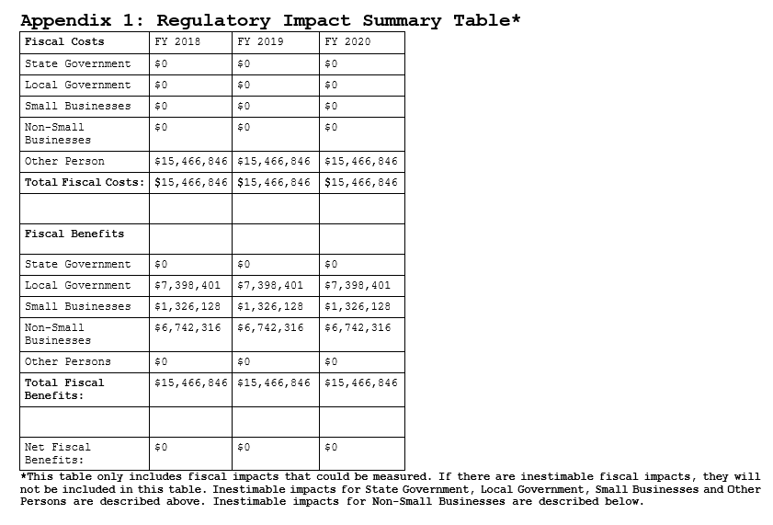
Example No. 1: Ambulance Rates
Step 4: Record the Required Information
15. Appendix 1: Regulatory Impact Summary Table
A Guide to Conducting a Regulatory Impact Analysis: The GOMB Criteria

Slide 50
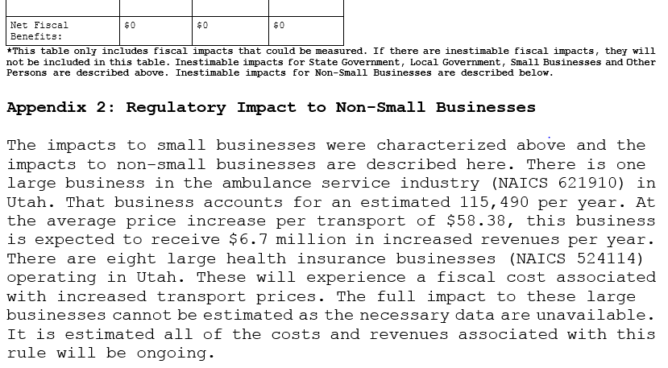
Example No. 1: Ambulance Rates
Step 4: Record the Required Information
15. Appendix 2: Regulatory Impact to Non-Small Businesses
A Guide to Conducting a Regulatory Impact Analysis: The GOMB Criteria

Slide 51
Example No. 2: Feeding the Disadvantaged
Example No. 2: R392-104 Feeding Disadvantages Groups
A Guide to Conducting a Regulatory Impact Analysis: The GOMB Criteria

Slide 52
Example No. 2: Feeding the Disadvantaged
Example 2: R392-104 Feeding Disadvantaged Groups
This was a “new rule” posted in the Utah State Bulletin in 2014 (No. 2014-14).
The rule eliminates the requirement for charitable organizations that their volunteers have food handler and/or food safety manager permits.
This example is useful for demonstrating fiscal and non-fiscal impacts as well as direct and indirect impacts.
A Guide to Conducting a Regulatory Impact Analysis: The GOMB Criteria
Notes:
Italicized and underlined “fiscal and non-fiscal impacts” and “direct and indirect impacts”

Slide 53
Example No. 2: Feeding the Disadvantaged
Step 1: Identify Affected Parties and Impacts
Begin by identifying the constrained party. In this case, the rule quite specifically focuses on charitable organizations (CO’s) as the constrained party because the rule allows them to use volunteers who have not obtained food handler or food safety manager permits.
Because CO’s are the constrained party and the transaction between CO’s and volunteers does not involve money, CO’s will experience a direct non-fiscal benefit.
Next, consider those who are indirectly impacted starting with what charities supply. Charitable organizations supply meals to disadvantaged groups.
Because CO’s will have easier access to volunteers, disadvantaged groups will likely receive more meals. Also, the transaction between disadvantaged groups and CO’s does not involve money, so disadvantaged groups will experience an indirect non-fiscal benefit.
A Guide to Conducting a Regulatory Impact Analysis: The GOMB Criteria
Notes:
Underlined “direct non-fiscal benefit” and “indirect non-fiscal benefit”

Slide 54
Example No. 2: Feeding the Disadvantaged
Step 1: Identify Affected Parties and Impacts
Consider what charitable organizations demand from other parties.
While charitable organizations demand clothing, blankets, and cash donations to serve disadvantaged groups, it seems clear the rule won’t affect suppliers of those goods to charitable organizations. However, charitable organizations demand labor services from volunteers to serve meals to disadvantaged groups.
Because volunteers are not the constrained party and will not have to pay money to obtain food handler permits, volunteers will experience an indirect fiscal benefit.
A Guide to Conducting a Regulatory Impact Analysis: The GOMB Criteria
Notes:
Underlined “indirect fiscal benefit”

Slide 55
Example No. 2: Feeding the Disadvantaged
Step 1: Identify Affected Parties and Impacts
Consider whether state or local government is impacted by the rule, no matter how distant the relationship might be to the constrained party.
Volunteers will no longer need to purchase training services or pay fees to local health departments, so local government is indirectly impacted by the rule, resulting in an indirect fiscal cost.
State government is not expected to be impacted.
A Guide to Conducting a Regulatory Impact Analysis: The GOMB Criteria
Notes:
Underlined “indirect fiscal cost”

Slide 56
Example No. 2: Feeding the Disadvantaged
Step 1: Identify Affected Parties and Impacts
Summary:
State Government: No Impact
Local Government: Indirect Fiscal Cost
Non-Small Businesses: No Impact
Other “Persons”
Charitable Organizations: Direct Non-Fiscal Benefit
Disadvantaged Groups: Indirect Non-Fiscal Benefit
Volunteers: Indirect Fiscal Benefit
A Guide to Conducting a Regulatory Impact Analysis: The GOMB Criteria

Slide 57
Example No. 2: Feeding the Disadvantaged
Step 2: Count the Number of Affected Individuals
To find the number of charitable organizations affected, go to the NAICS website and search for the industry. The term “charities” didn’t yield the right results, but the term “homeless” provides the right industry. The NAICS code is 624221, and the industry is “Temporary Shelters.”
Go to DWS’s FirmFind webpage and enter the code 624221. The results show that 24 temporary shelters are in Utah that will be affected by the rule.
The disadvantaged group is essentially the same as the homeless population. From DWS’s Comprehensive Report on Homelessness 2016, it was estimated that approximately 2,800 homeless people were in Utah during 2016. Using this number, there are 2,800 disadvantaged individuals.
A Guide to Conducting a Regulatory Impact Analysis: The GOMB Criteria

Slide 58
Example No. 2: Feeding the Disadvantaged
Step 2: Count the Number of Affected Individuals
To find the number of volunteers potentially impacted, check the fiscal note associated with the bill that produced the rule. House Bill 176 (2014 General Sessions) had a fiscal note attached that estimated 100 volunteers would be impacted.
If a rule comes from a bill, the fiscal note should always be examined. However, fiscal notes are not always comprehensive and may not consider impacts to parties that need to be included in a regulatory impact analysis. If the fiscal note did not have an estimate of the number of volunteers impacted, the rules coordinator should contact several temporary shelters to get an estimate of how many volunteers usually work for them serving meals.
A Guide to Conducting a Regulatory Impact Analysis: The GOMB Criteria

Slide 59
Example No. 2: Feeding the Disadvantaged
Step 3: Estimate the Fiscal Impacts
The two groups that experience fiscal impacts are volunteers and local government. To come up with accurate estimates, we need to know how many individuals no longer need food handler training and how many no longer need food safety manager training. We also need to know the fees, training costs, and who provides the training.
Contacting the local health department, a knowledgeable employee states that for all permits issued, roughly 80% are food handler permits and 20% are food safety manager permits. Based on this information, 80 volunteers are assumed to no longer need food handler permits and 20 no longer need food safety manager permits.
A Guide to Conducting a Regulatory Impact Analysis: The GOMB Criteria

Slide 60
Example No. 2: Feeding the Disadvantaged
Step 3: Estimate the Fiscal Impacts
For either type of permit, the local health department collects a $15 application fee. In addition, local health departments offer food handler training for $10 per person. Local health departments do not offer food safety manager training, so those services are provided by private businesses.
The local health department also reports that half of all applicants for food handler permits take the training from the health department, while the rest use private online training providers (see bullet point below). Local government will lose $1,500 in permit fees (100 x $15) and $400 in trainings (40 x $10). Thus, the indirect fiscal cost to local government is $1,900 per year.
A Guide to Conducting a Regulatory Impact Analysis: The GOMB Criteria

Slide 61
Example No. 2: Feeding the Disadvantaged
Step 3: Estimate the Fiscal Impacts
Volunteers will no longer need to pay the $15 fee. The 80 who would have purchased food handler training for $10 no longer need to purchase it. After researching online, we assess food safety manager training costs roughly $100 and 20 volunteers will no longer need to purchase it.
Volunteers benefit from not having to pay $1,500 (100 x $15) in fees to the local health departments. They also benefit by $800 (80 x $10) for not having to buy food handler trainings and by $2,000 (20 x $100) for not having to buy food safety manager trainings. Therefore, volunteers experience an indirect fiscal benefit of $4,300 per year.
A Guide to Conducting a Regulatory Impact Analysis: The GOMB Criteria

Slide 62
Example No. 2: Feeding the Disadvantaged
Step 4: Record the Required Information
7. Aggregate anticipated cost or savings to:
A. State Budget: This rule is not expected to have any impacts on state government revenues or expenditures as food handler permit/ food safety manager training is not offered by the state.
B. Local Government: Approximately 100 volunteers will no longer need to acquire food handler permits or food safety manager permits. The fee for either permit is $15, so local health departments will experience a loss of $1,500. In addition, approximately 40 individuals will no longer pay $10 for food handler training, which implies another cost of $400. The total anticipated cost to local government is estimated to be $1,900.
A Guide to Conducting a Regulatory Impact Analysis: The GOMB Criteria

Slide 63
Example No. 2: Feeding the Disadvantaged
Step 4: Record the Required Information
7. Aggregate anticipated cost or savings to:
C. Small Businesses: No small businesses engaging in the same immediate markets with charitable organizations in Utah are expected to be impacted because of this rule.
A Guide to Conducting a Regulatory Impact Analysis: The GOMB Criteria

Slide 64
Example No. 2: Feeding the Disadvantaged
Step 4: Record the Required Information
7. Aggregate anticipated cost or savings to:
D. Other Persons: Of an estimated 100 volunteers, 80 will no longer pay $25 to acquire food handler permits and 20 will no longer need to pay $115 for food safety manager permits. Volunteers will receive an indirect fiscal benefit of $4,300. As many as 24 charitable groups may experience an increase in volunteers that allows them to serve more meals, which is a direct non-fiscal benefit to these groups. Furthermore, up to 2,800 disadvantaged individuals will experience an indirect non-fiscal benefit in the form of receiving more meals from the charitable organizations.
A Guide to Conducting a Regulatory Impact Analysis: The GOMB Criteria

Slide 65
Example No. 2: Feeding the Disadvantaged
Step 4: Record the Required Information
9. Department Head Comments
A. Comments by the department head on the fiscal impact the rule may have on businesses: After conducting a thorough analysis, it was determined that this proposed rule will not result in a fiscal impact to businesses.
A Guide to Conducting a Regulatory Impact Analysis: The GOMB Criteria

Slide 66
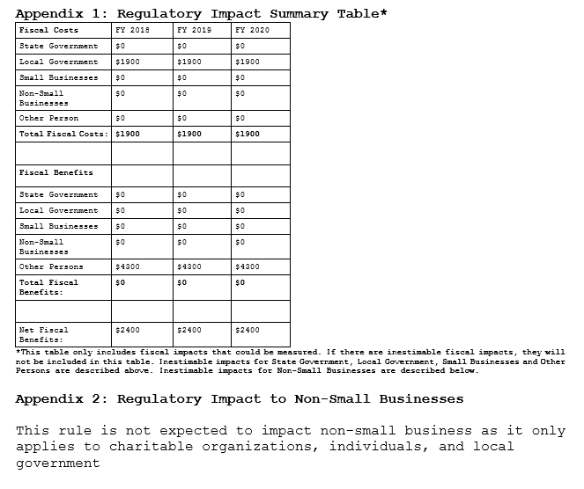
Example No. 2: Feeding the Disadvantaged
Step 4: Record the Required Information
15. Appendix 1 and 2
A Guide to Conducting a Regulatory Impact Analysis: The GOMB Criteria

Slide 67
Online Data Resources
Census Bureau’s North American Industry Classification System (NAICS) page: https://www.census.gov/eos/www/naics/
Department of Workforce Services’ FirmFind: https://jobs.utah.gov/jsp/firmfind/welcome.do
Department of Workforce Services Workforce Information: https://jobs.utah.gov/wi/index.html
Bureau of Labor Statistics: https://www.bls.gov/
Bureau of Economic Analysis: https://www.bea.gov/
Census Bureau’s American FactFinder: https://factfinder.census.gov/faces/nav/jsf/pages/index.xhtml
Kem C. Gardner Policy Institute: http://gardner.utah.edu/
Utah State Tax Commission Economics and Statistical Unit: http://tax.utah.gov/econstats
Formatting Template for Appendix 1 and 2: https://rules.utah.gov/agency-resources/
Scroll down and download file entitled “Fiscal Analysis Table Template to include within rules (.rtf filings)
A Guide to Conducting a Regulatory Impact Analysis: The GOMB Criteria

Slide 68
Contact Information
Mike Broschinsky, Office of Administrative Rules
Phone: (801) 538-3003 | Email: mbroschi@utah.gov
Jeffrey Van Hulten, Governor’s Office of Economic Development
Phone: (801) 673-9776 | Email: jeffreyvan@utah.gov
Colby Oliverson, Governor’s Office of Management and Budget
Phone: 801-891-8536 | Email: coliverson@utah.gov
Nate Talley, Governor’s Office of Management and Budget
Phone: (801) 538-1556 | Email: natetalley@utah.gov
A Guide to Conducting a Regulatory Impact Analysis: The GOMB Criteria

Slide 69
Properly Formatted RTF File
Formatting Template for Appendix 1 and 2: https://rules.utah.gov/agency-resources/
Scroll down and download the file entitled “Fiscal Analysis Table Template to include within rules (.rtf filings)
Remember to follow this formatting exactly (font, font size, table size).

